Slide 1
Investment Advisor
Presented by Ayush, Sandeep , Raj & Jagadeesh

Slide 2
Stock Profiles
1.High Risk Taking
2.Risk Taking
3.Moderate Risk Taking
4.Low Risk Taking

Slide 3
Corelation between Market Capital and Dividend per share
The corelation between the two columns is positive which means that when one increases the other also increases
Corelation value is 0.04 between the dividend and the market cap.
Having this value means that the market cap has slight influence on the dividend per share.

Slide 4
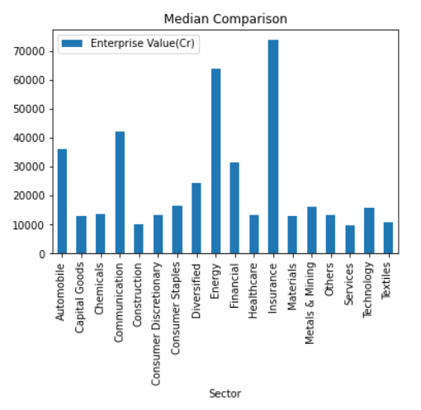
Comparison of enterprise value for all the different sectors
The most booming sectors are insurance and the energy sector followed by communication and automobile
Investing in these sectors can be beneficial for the investors.

Slide 5
Personal Data Analysis
expenses
income

Slide 6
Income and expense comparison
Based on the given data the expense are more than the income so this person cannot invest in any company he has to save more to be able to invest in stock market .
Also if we have the passbook of the person with the right data we would be able to tell the person where he can invest in.

Slide 7
Conclusion and challenges faced
According to the personal profile the person trying to invest does not have any saving for investment
Understanding the data of the stock market
Updating he google straight from python
Understanding API’s
Handling the Json file for requests

Slide 8
Thank you !

